Slide 1
Introduction to Cloud Computing
ITI

Slide 2
Agenda
What is Cloud Computing
Three Cloud Computing Categories
Cloud Computing pros and cons
Conclusion

Slide 3
Quiz

Slide 4
عرف ما يأتي
Cloud Computing

Slide 5
Definitions
…moving computing and data away from the desktop and the portable PC and simply displaying the results of computing that takes place in a centralized location and is then transmitted via internet to user’s screen.
- John Markoff
(NY Times Blog)

Slide 6
Cloud computing is a general term for anything that involves delivering hosted services over the Internet.
-whatis.com

Slide 7
…the idea of relying on Web-based application and storing data in the “CLOUD” of the internet.
-MIT Technology Review

Slide 8
What is Cloud Computing ?
The cloud itself is a set of hardware, networks, storage, services, and interfaces that enable the delivery of computing as a service. Cloud services include the delivery of software, infrastructure, and storage over the Internet based on user demand.

Slide 9

What is Cloud Computing ?
“Cloud” is simply a metaphor for the internet
Users do not have or need knowledge, control, ownership in the computer infrastructure
Users simply rent or access the software, paying only for what they use
Notes:
The cloud metaphor is actually a good one. A cloud is a huge collection of tiny droplets of water. Some of those droplets will fall on my yard, providing the trees and bushes with water. Some will fall onto land where it will run off into the reservoir which my drinking water comes from. Clouds grow from evaporated water, which comes from all over the place. When it comes to clouds, what I care about is that enough water falls on my yard to keep the plants alive, and that enough water winds up in my reservoir so that I have enough to drink. I don't care which cloud drops water on my yard. I don't care where on earth that water came from. To me, it's all just water - every droplet is pretty much exactly the same, and I can't tell the difference. So long as I get enough, I'm happy.

Slide 10
What is Cloud Computing ?
“Cloud computing is a general term for anything that involves delivering hosted services over the internet.” – Wikipedia
“Cloud computing is Internet-based computing, whereby shared resources, software, and information are provided to computers and other devices on demand, like the electricity grid.”- Wikipedia
Basically a cloud is a virtualization of resources that manages and maintains itself.

Slide 11
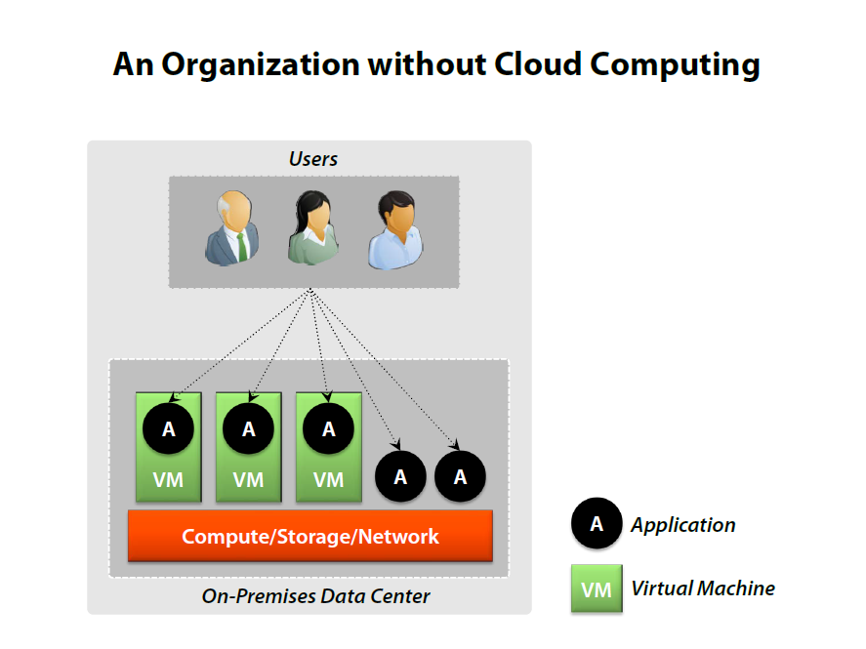

Slide 12
Categorizing Cloud Computing Three categories
Cloud applications
Often called Software as a Service (SaaS)
Cloud platforms
Public cloud platforms
Private clouds
On-premises cloud platforms

Slide 13
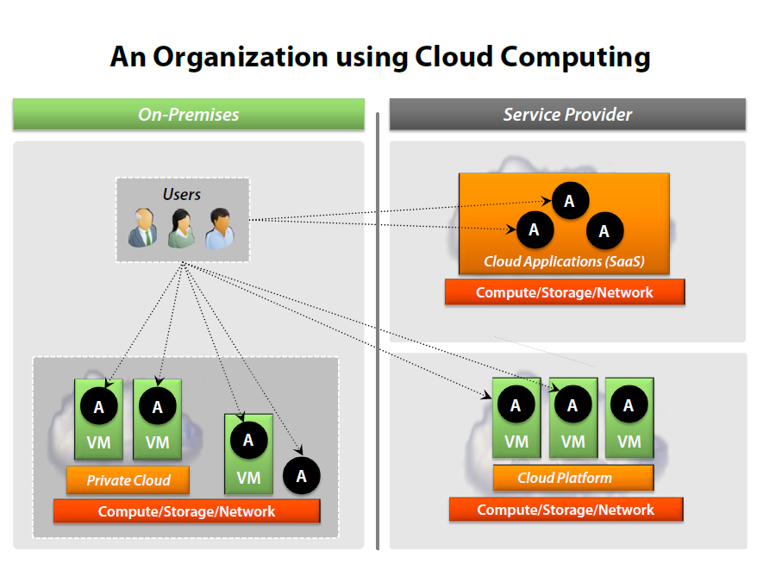

Slide 14
Cloud Applications: Software as a Service

Slide 15
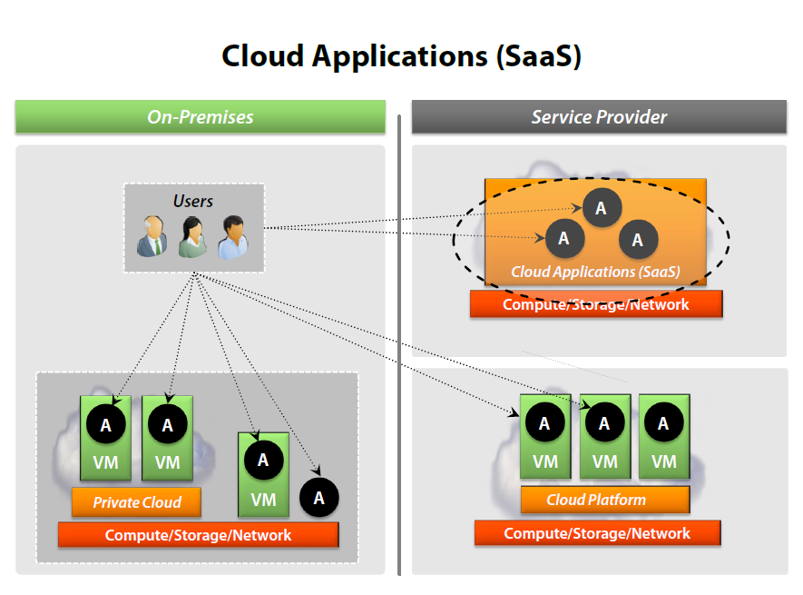

Slide 16
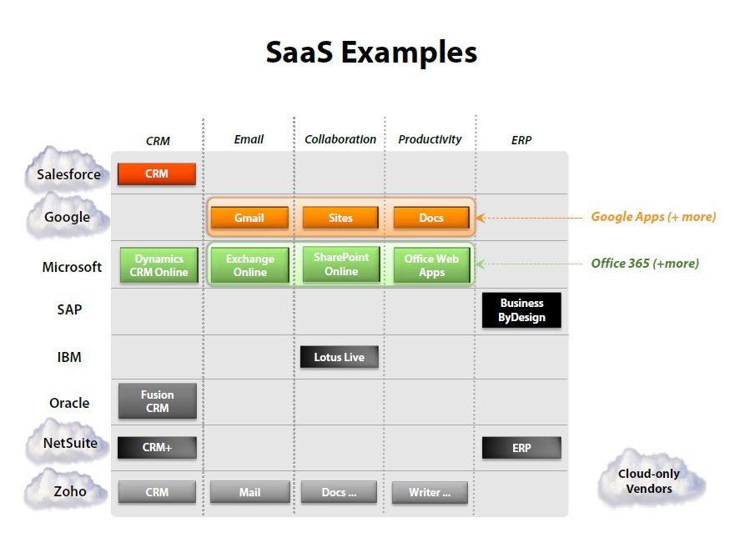

Slide 17
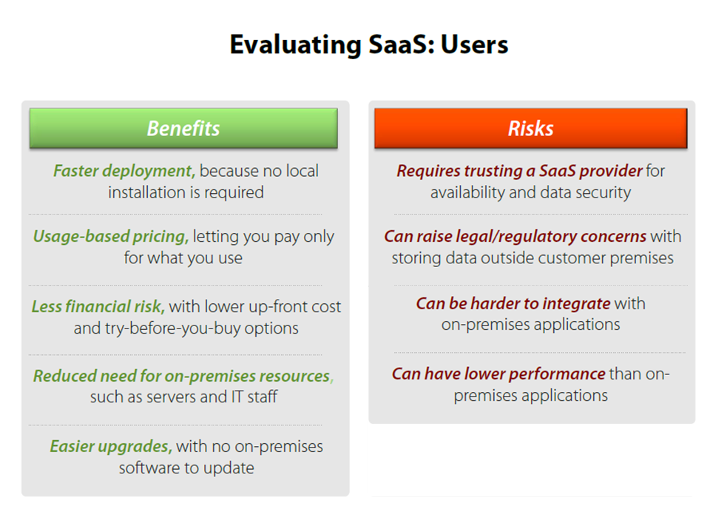
Notes:
Multi-tenancy is an architecture in which a single instance of a software application serves multiple customers.
Each customer is called a tenant. Tenants may be given the ability to customize some parts of the application, such as color of the user interface (UI) or business rules, but they cannot customize the application's code.
Multi-tenancy can be economical because software development and maintenance costs are shared.
It can be contrasted with single-tenancy, an architecture in which each customer has their own software instance and may be given access to code.
With a multi-tenancy architecture, the provider only has to make updates once.
With a single-tenancy architecture, the provider has to touch multiple instances of the software in order to make updates.
In cloud computing, the meaning of multi-tenancy architecture has broadened because of new service models that take advantage of virtualization and remote access. A software-as-a-service (SaaS) provider, for example, can run one instance of its application on one instance of a database and provide web access to multiple customers. In such a scenario, each tenant's data is isolated and remains invisible to other tenants.
http://whatis.techtarget.com/definition/multi-tenancy
A tenant is a group of users who share a common access with specific privileges to the software instance

Slide 18
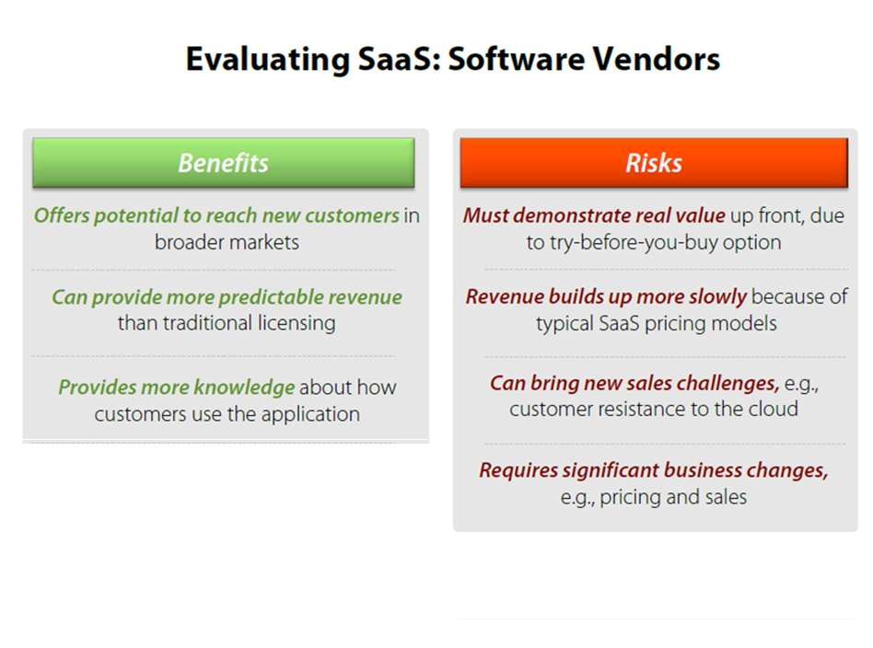

Slide 19
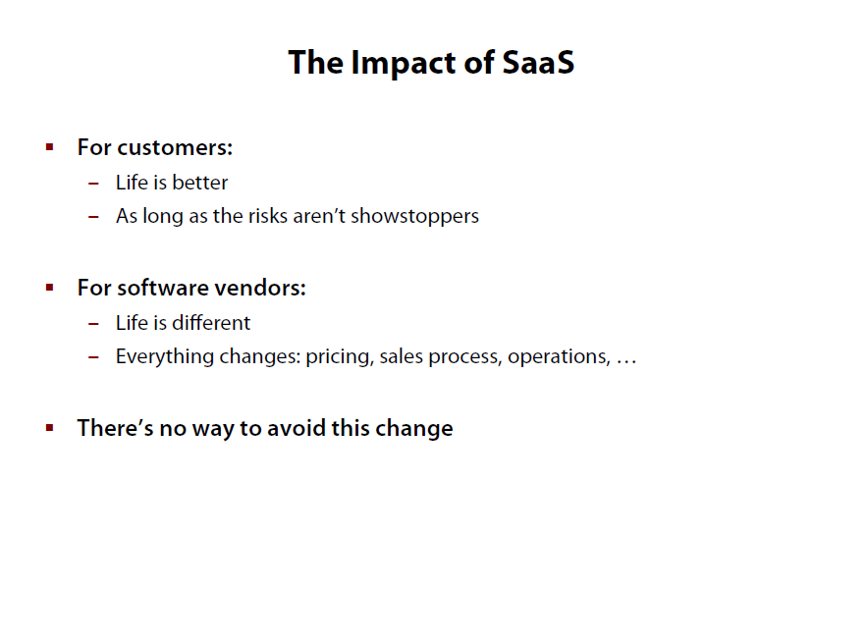

Slide 20
Cloud Platforms

Slide 21
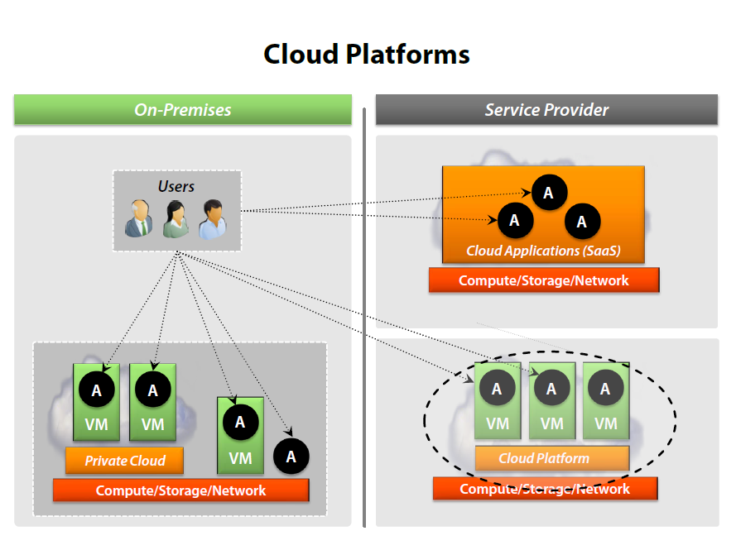

Slide 22
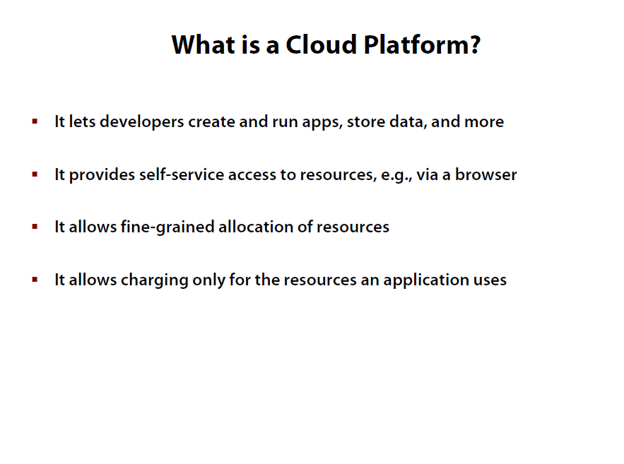

Slide 23
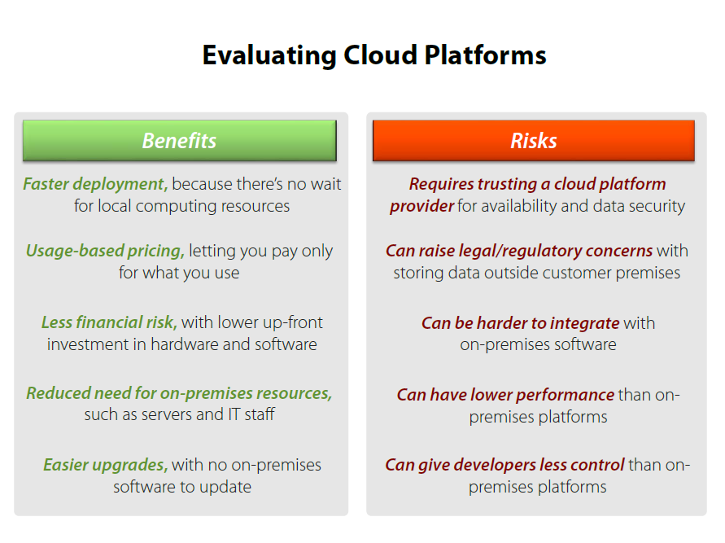

Slide 24
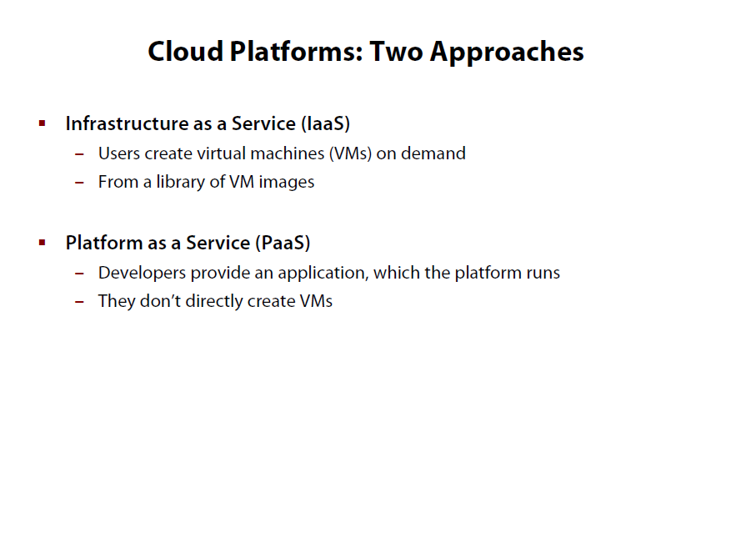

Slide 25
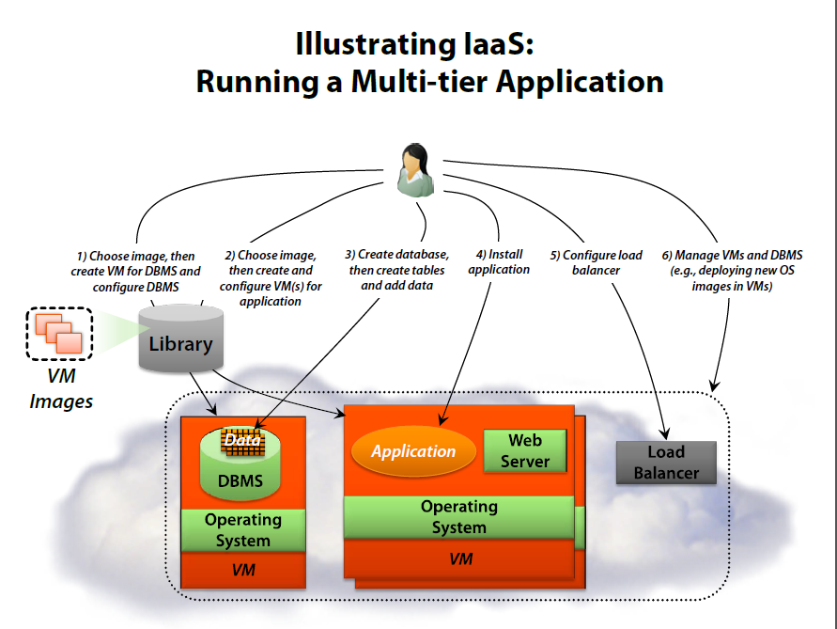

Slide 26
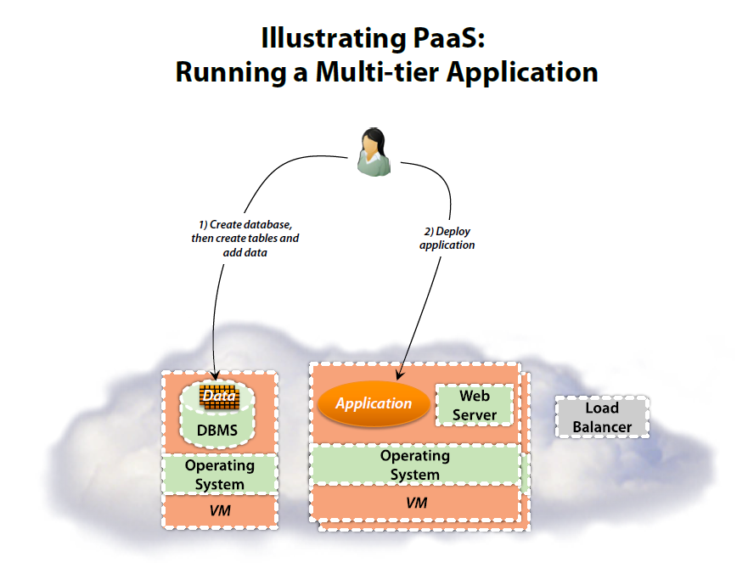

Slide 27
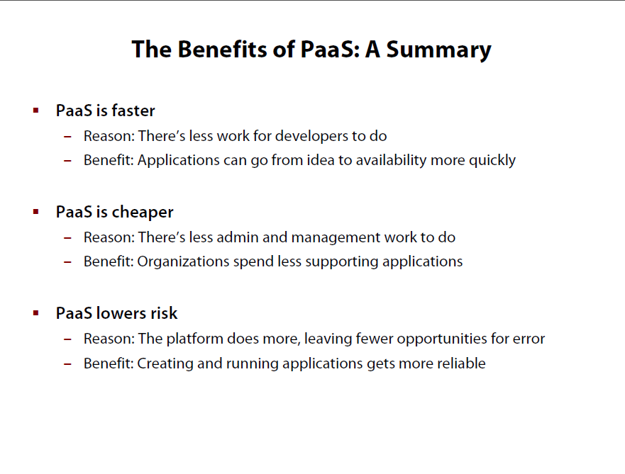

Slide 28
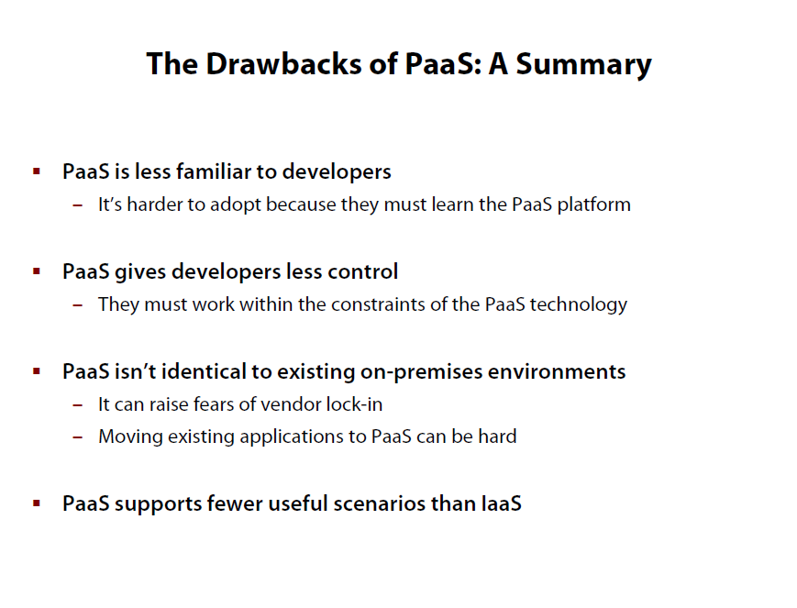

Slide 29
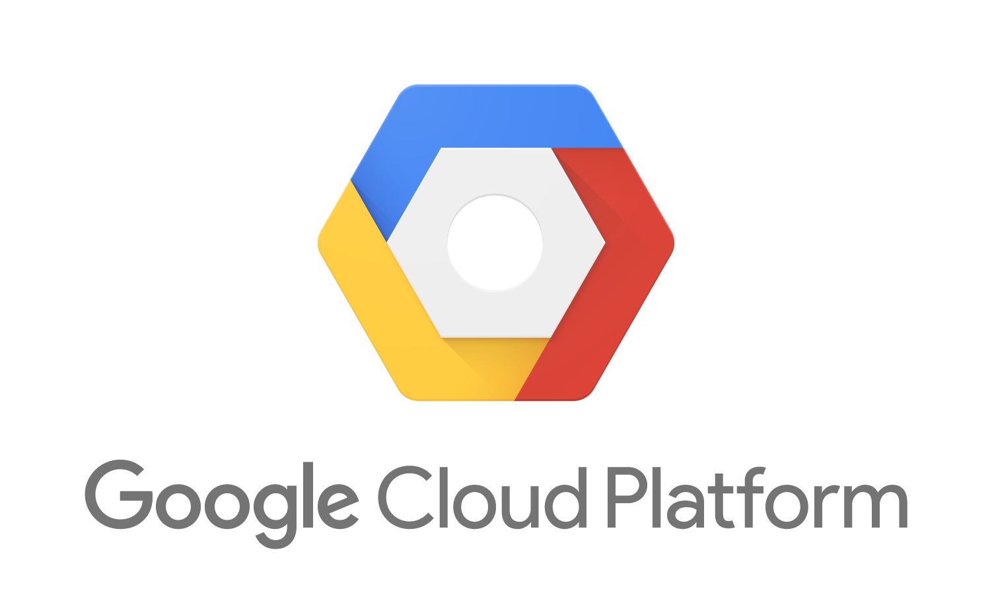
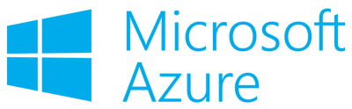
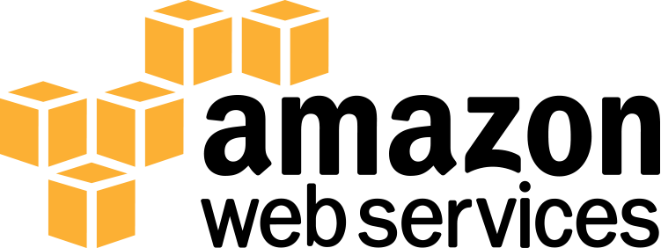
Cloud Platforms Examples

Slide 30
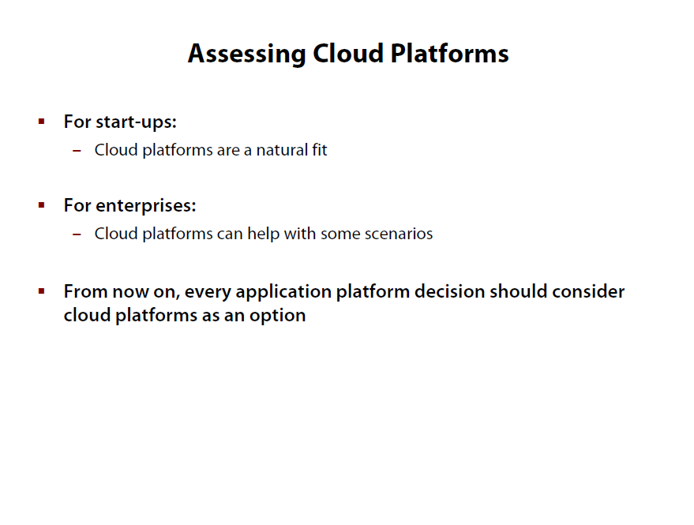

Slide 31
Private Clouds

Slide 32
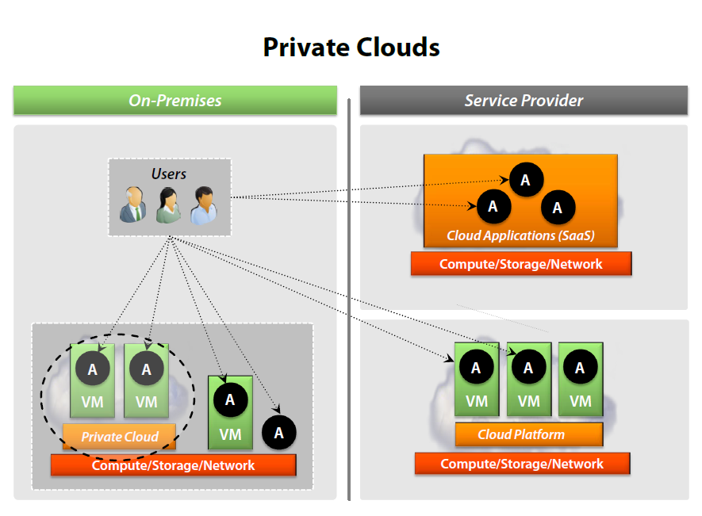

Slide 33
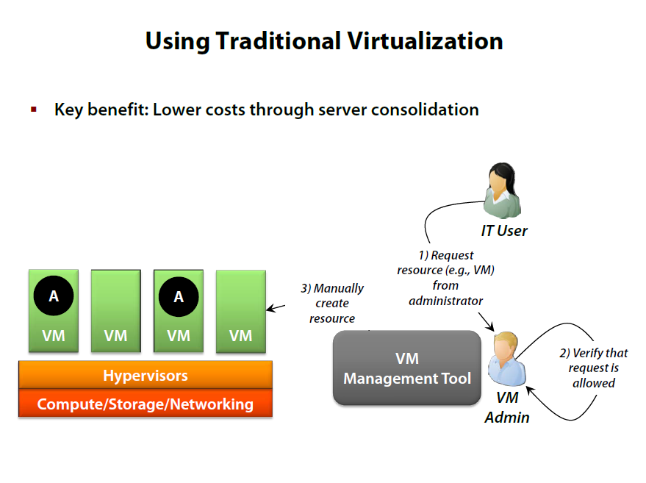

Slide 34
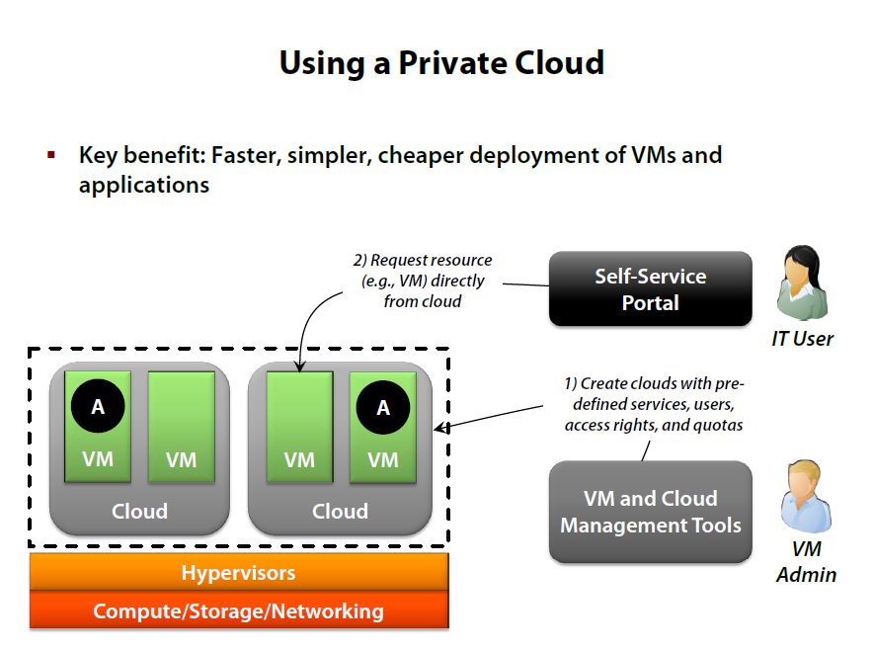

Slide 35
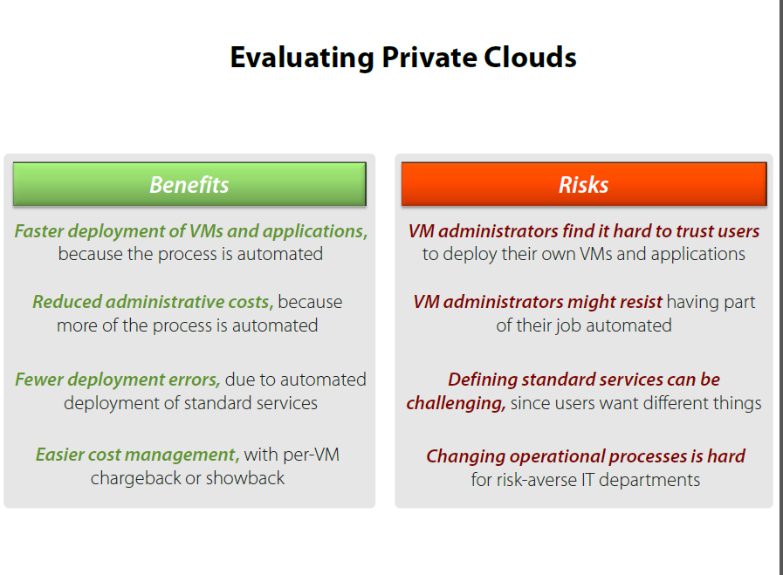

Slide 36
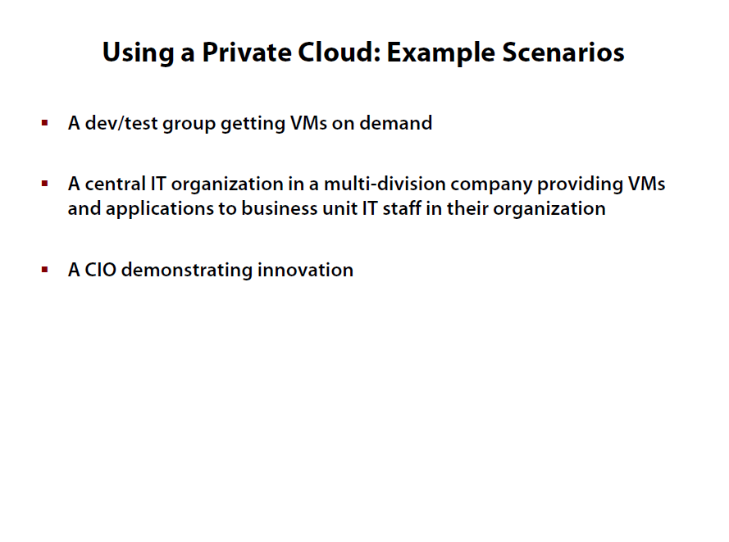

Slide 37
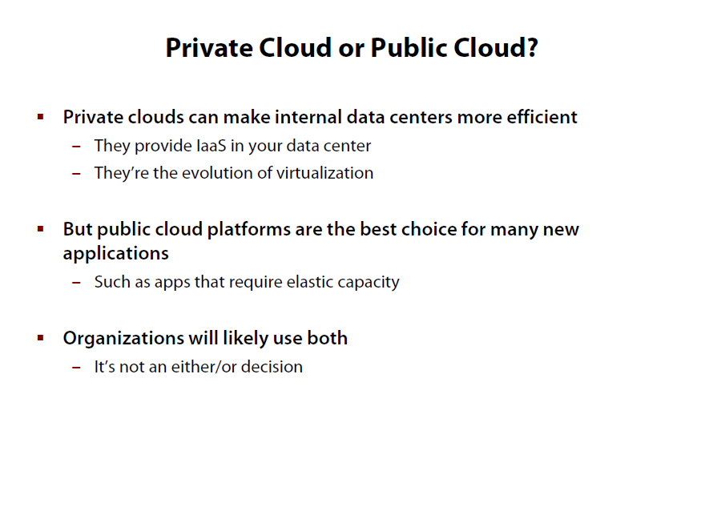

Slide 38
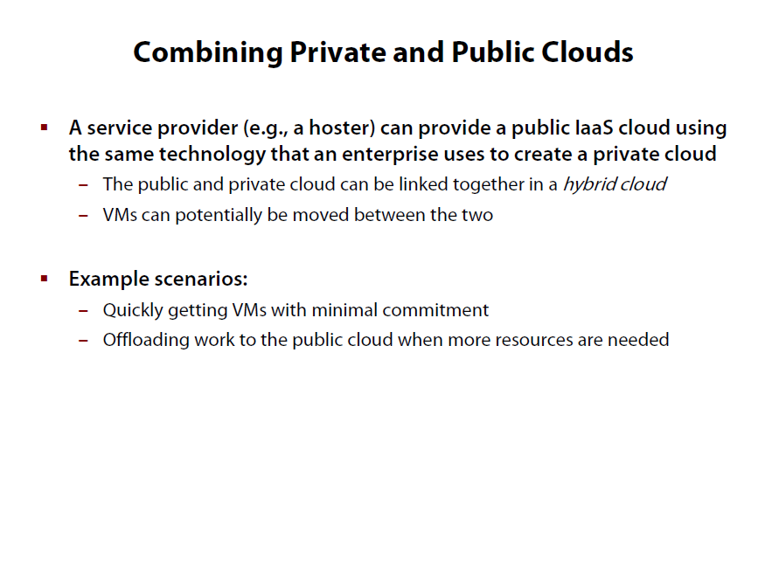

Slide 39
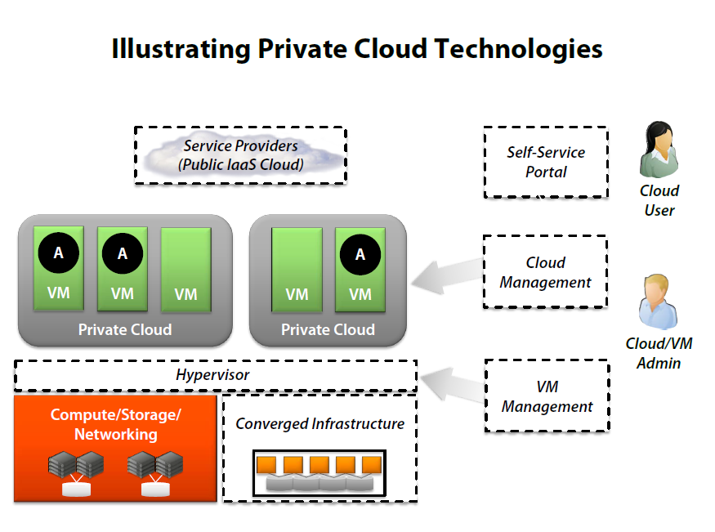

Slide 40
Private Cloud Examples
VMware
Microsoft
HP
OpenStack
….

Slide 41
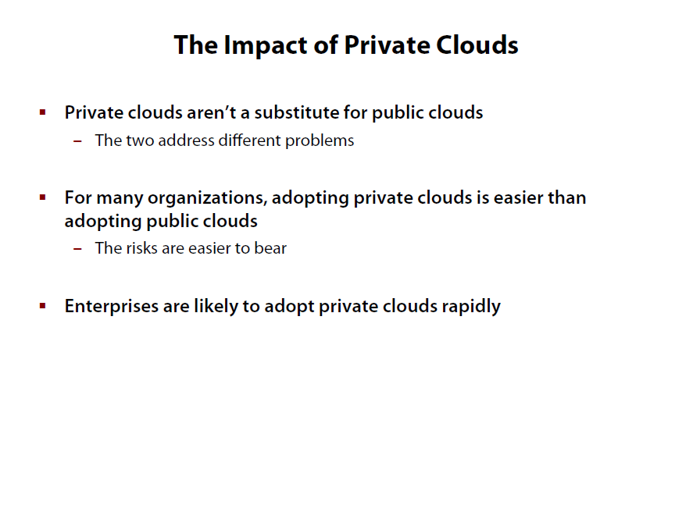

Slide 42
Cloud Center characteristics
the cloud embodies the following four basic characteristics
Elasticity and the ability to scale up and down
Self-service provisioning and automatic de-provisioning
Application programming interfaces (APIs)
Billing and metering of service usage in a pay-as-you-go model

Slide 43
1- Elasticity and scalability
The service provider can't anticipate how customers will use the service
The service needs to be available all the time (7 days a week, 24 hours a day)
It has to be designed to scale upward for high periods of demand
Scalability is achieved by providing elasticity
Rubber band
Notes:
The service provider can't anticipate how customers will use the service. One customer might use the service three times a year during peak selling seasons, whereas another might use it as a primary development platform for all of its applications.
NOTE
Therefore, the service needs to be available all the time (7 days a week, 24 hours a day) and it has to be designed to scale upward for high periods of demand and downward for lighter ones. Scalability also means that an application can scale when additional users are added and when the application requirements change.
This ability to scale is achieved by providing elasticity. Think about the rubber band and its properties. If you're holding together a dozen pens with a rubber band, you probably have to fold it in half. However, if you're trying to keep 100 pens together, you will have to stretch that rubber band. Why can a single rubber band accomplish both tasks? Simply, it is elastic and so is the cloud.

Slide 44
2- Self-service provisioning
Customers can easily get cloud services without going through a lengthy process
Contrast this on-demand response with the process at a on-premises data center(Request Process)
The organization still needs to do its homework. These services aren't free
Requirements must be determined before
Notes:
Customers can easily get cloud services without going through a lengthy process. The customer simply requests an amount of computing, storage, software, process, or other resources from the service provider.
Contrast this on-demand response with the process at a typical data center. When a department is about to implement a new application, it has to submit a request to the data center for additional computing hardware, software, services, or process resources. The data center gets similar requests from departments across the company and must sort through all requests and evaluate the availability of existing resources versus the need to purchase new hardware. After new hardware is purchased, the data center staff has to configure the data center for the new application. These internal procurement processes can take a long time, depending on company policies.
NOTE
Of course, nothing is as simple as it might appear. While the on-demand provisioning capabilities of cloud services eliminates many time delays, an organization still needs to do its homework. These services aren't free; needs and requirements must be determined before capability is automatically provisioned.

Slide 45
3- Application programming interfaces (APIs)
Cloud services need to have standardized APIs
A standardized interface lets the customer more easily link a cloud service
CRM Apps
Notes:
Cloud services need to have standardized APIs. These interfaces provide the instructions on how two application or data sources can communicate with each other.
A standardized interface lets the customer more easily link a cloud service, such as a customer relationship management system with a financial accounts management system, without having to resort to custom programming

Slide 46
4- Billing and metering of services
A cloud environment needs a built-in service that bills customers
Usage has to be metered (tracked).
Notes:
Yes, there is no free lunch. A cloud environment needs a built-in service that bills customers. And, of course, to calculate that bill, usage has to be metered (tracked). Even free cloud services (such as Google's Gmail or Zoho's Internet-based office applications) are metered.

Slide 47
Cloud Center characteristics
In addition to these characteristics, cloud computing must have two overarching requirements to be effective:
A comprehensive approach to service management
A well-defined process for security management

Slide 48
Performance monitoring and measuring
A cloud service provider must include a service management environment.
A service management environment is an integrated approach for managing your physical environments and IT systems.
Service management has to monitor and optimize the service or sets of services.
Many cloud service providers give customers a dashboard
Notes:
A cloud service provider must include a service management environment. A service management environment is an integrated approach for managing your physical environments and IT systems. This environment must be able to maintain the required service level for that organization.
In other words, service management has to monitor and optimize the service or sets of services. Service management has to consider key issues, such as performance of the overall system, including security and performance. For example, an organization using an internal or external email cloud service would require 99.999 percent uptime with maximum security. The organization would expect the cloud provider to prove that it has met its obligations.
Many cloud service providers give customers a dashboard — a visualization of key service metrics — so they can monitor the level of service they're getting from their provider. Also, many customers use their own monitoring tools to determine whether their service level requirements are being met.

Slide 49
Security
A customer should trust that the cloud service is safe
Information can't be accidentally accessed by another company or by a hacker
Notes:
Many customers must take a leap of faith to trust that the cloud service is safe. Turning over critical data or application infrastructure to a cloud-based service provider requires making sure that the information can't be accidentally accessed by another company (or maliciously accessed by a hacker).

Slide 50
Cloud Computing Pros
Reduced Hardware equipment for end users
Improved Performance
Lower Hardware and Software Maintenance
Instant Software Updates
Accessibility
Less Expensive
Better Collaboration
Pay for what you use
Flexible

Slide 51
Cloud Computing Cons
Security Issues (#1 concern)
Internet connection
Location of Servers
Speed

Slide 52
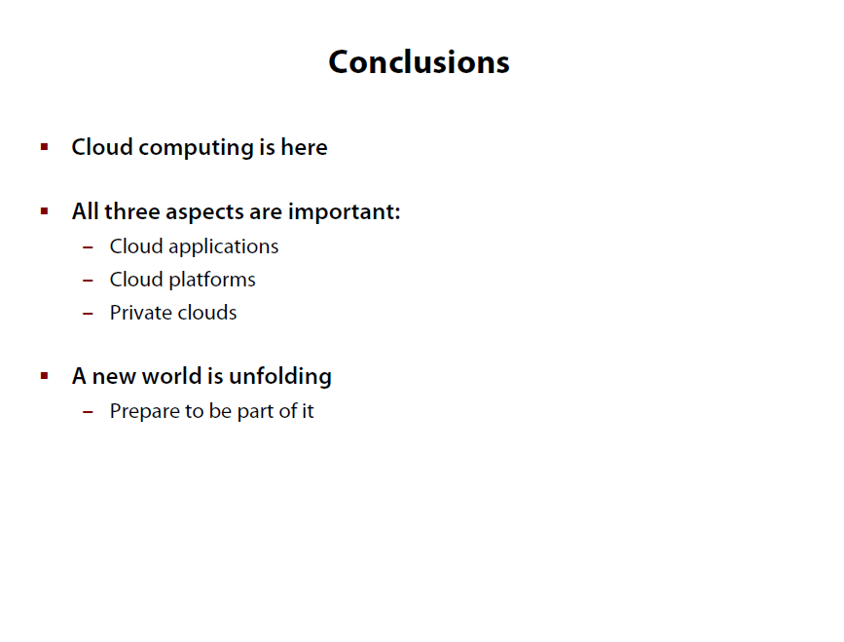
\78

